Slide 1
Software Quality Assurance and Testing Technology
2nd Semester, Spring 2022
Xiaoping CHE (xpche@bjtu.edu.cn)
Associate Professor
School of Software Engineering
Beijing Jiaotong University

Slide 2
Rules
25mins per Section
5mins break after a Section
10:10-10:35
10:40-11:05
11:10-11:35
11:40-12:00

Slide 3
Rules
Project 20%
Assignments 40%
Final Exam 40%

Slide 4
How
16 Weeks Plan
Week 1: The basic concepts and theories of testing
Week 2-3: Principles of Testing
Week 4-5: Requirements and test case management
Week 6-7: Design of Test Cases
Week 8: Unit Testing
Week 9: Integration Testing
Week 10-11: System Testing
Week 12: Regression Testing
Week 13-14: Software Testing Management
Week 15: International and Local Testing
Week 16: Future of Testing

Slide 5

How
References
Ron Patton, Software Testing (2th Edition)
Glenford J. Myers, The Art of Software Testing (3rd Edition)
Gerald M. Weinberg, Perfect Software

Slide 6
Short Review

Slide 7
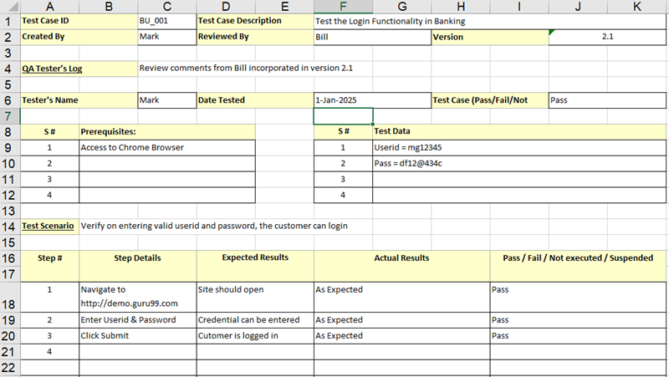
Example (Test case)

Slide 8
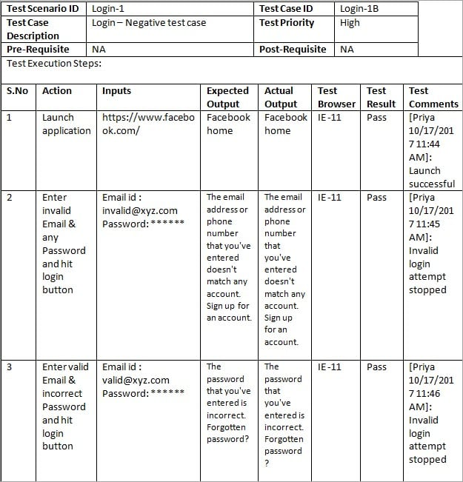
Example (Test case)

Slide 9
THE SOFTWARE LIFE CYCLE
Begins when an application is first conceived.
Ends when it is no longer in use.
Includes:
Initial conception
Requirements/ specification analysis
Functional design
Internal design
Documentation planning
Test planning
Coding
Documenting
Integration
Testing
Maintenance
Updates
Retesting
Phase-out
Many different models are possible for sequencing
these activities!

Slide 10
Activities in SDLC
Project Planning
Analysis
Design
Implement
Test
Roll-out
Initiate project & Organize
UI Design
User Req’ts
Req’ts Analysis
Project Definition & Planning
Technical Design
Detailed Design
Perform Integration Test
Perform System Test
Coding
Convert Site
Quality Requirements
Management Review & Approval
Quality Verification
Test Planning & Preparation
User Procedure & Training
Roll-out Planning & Preparation

Slide 11
Waterfall Model with Prototyping
Requirements Analysis
System Design
Program Design
Coding Unit Test
Integration Testing
Prototyping
System Testing
User/Customer
Acceptance Testing
Operation maintenance

Slide 12
Introduction
A test executing the fault may not produce an error!
public static void CSta (int [ ] numbers)
{
int length = numbers.length;
double mean, sum;
sum = 0.0;
for (int i = 1; i < length; i++)//i=0
{
sum += numbers [ i ];
}
mean = sum / (double) length;
System.out.println ("mean: " + mean);
}
Test Input: [0,4,5]
sum=0+4+5
sum=4+5
Not an error for “sum”
mean=3
mean=3

Slide 13
Rapid Application Development (RAD) - V Model
Operation maintenance
Validate requirements
Requirements Analysis
Acceptance Testing
System Design
System Testing
Verify design
Program Design
Unit Test Integration Testing
Design/Analysis
Verify/testing
Coding

Slide 14
VERIFICATION
The process of evaluating a system or component during the development process to determine whether it satisfies the specifications.
THE CRITICAL QUESTION IS:
- Did we build what we planned to build?
Typically involves reviews and meetings to evaluate:
documents
plans
code
requirements
specifications

Slide 15
VALIDATION
The process of evaluating a system or component during the development process to determine whether it satisfies the user's requirements
THE CRITICAL QUESTION IS
“Did we build what the user wanted?”

Slide 16
Verification vs. Validation
Verification confirms that the software meets its specification.
- Are we building the product right？
Validation confirms that the software meets the user’s requirements.
- Are we building the right product ?
Never assume the specifications are correct when testing, Both V&V tests must be performed.
Example: The mirror of Hubble Space Telescope was ground incorrectly (because the specs were wrong) and, consequently, it failed to produce clear pictures when originally launched.

Slide 17
Principle of Testing
?
Which one sounds correct …
Testing is the process of demonstrating that errors are not present.
The purpose of testing is to show that a program performs its intended functions correctly.
Testing is the process of executing a program with the intent of finding errors.
Testing is the process of establishing confidence that a program does what it is supposed to do.

Slide 18
Principle of Testing
Software process models are an ideal … not reality
No software development effort follows a process model perfectly. Why?
The specification never corresponds to the customers needs perfectly.
There is never enough time to perform all of the testing.
Nevertheless, an ideal model is helpful to make progress.
Trade offs and concessions are inevitable.

Slide 19
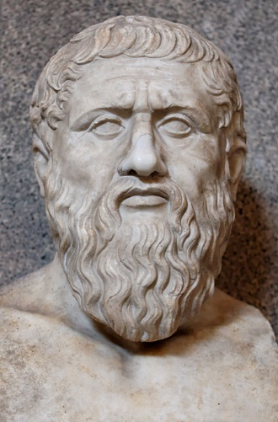
Principle of Testing
Plato had some interesting things to say about the ideal
Physical objects and physical events are shadows of their ideal or perfect forms
They exist only to the extent that they instantiate the perfect versions of themselves.
However, real physical objects are fleeting phenomena, the ideals of which they are mere instances.
Plato believed in perfect justice, perfect chairs, etc.
He would have also believed that the Waterfall model (or some variant of it) was a perfect process model :-)
427 – 347 B.C.

Slide 20
Principle of Testing
Software testing axioms
It is impossible to test a program completely.
Software testing is a risk-based exercise.
Testing cannot show the absence of bugs.
The more bugs you find, the more bugs there are.
Not all bugs found will be fixed.
It is difficult to say when a bug is indeed a bug.
Specifications are never final.
Software testers are not the most popular members of a project.
Software testing is a disciplined and technical profession.

Slide 21
Principle of Testing
Parenthesis: What is an axiom anyway?
An axiom is a sentence or proposition that is not proved or demonstrated and is considered as obvious or as an initial necessary consensus for a theory building or acceptation.
Therefore, it is taken for granted as true, and serves as a starting point for deducing and inferring other (theory dependent) truths.

Slide 22

Principle of Testing
Peano’s axioms for the structure of natural numbers
1 is a natural number.
Every natural number is equal to itself (equality is reflexive).
For all natural numbers a and b, a = b if and only if b = a (equality is symmetric).
For all natural numbers a, b, and c, if a = b and b = c then a = c (equality is transitive).
If a = b and b is a natural number then a is a natural number.
If a is a natural number then successor(a) is a natural number.
If a and b are natural numbers then a = b if and only if successor(a) = successor(b).
If a is a natural number then successor(a) is not equal to 1.
For every set K, if 1 is in K, and successor(x) is in K for every natural number x in K, then every natural number is in K.

Slide 23
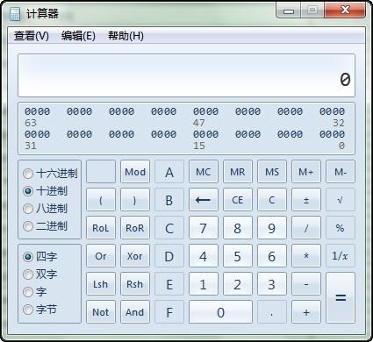
Principle of Testing
Axiom 1 It is impossible to test a program completely
How many test cases do you need to exhaustively test:
Powerpoint
A calculator
MS Word
Any interesting software!
The only way to be absolutely sure software works is to run it against all possible inputs and observe all of its outputs …
Oh, and the specification must be correct and complete.

Slide 24
Principle of Testing
Axiom 1 (cont’d) It is impossible to test a program completely
The number of possible inputs is very large.
The number of possible outputs is very large.
The number of paths through the software is very large.
The software specification open to interpretation.

Slide 25
Principle of Testing
Axiom 2 Software testing is a risk-based exercise
If you do not test the software for all inputs (a wise choice) you take a risk.
Hopefully you will skip a lot of inputs that work correctly.
What if you skip inputs that cause a fault?
Risk: financial loss, security, loss of money, loss of life!
That is a lot of pressure for a tester!
This course is all about techniques and practices to help reduce the risk without breaking the bank.

Slide 26
Principle of Testing
Axiom 2 (cont’d) Software testing is a risk-based exercise
If you try to test too much, the development cost becomes prohibitive.
If you test too little, the probability of software failure increases and as we discussed … software failures can cost us big time!
Number of
Missed Bugs
Cost of
Testing
Quantity
Under
Testing
Testing
Equilibrium
Over
Testing
Amount of Testing

Slide 27
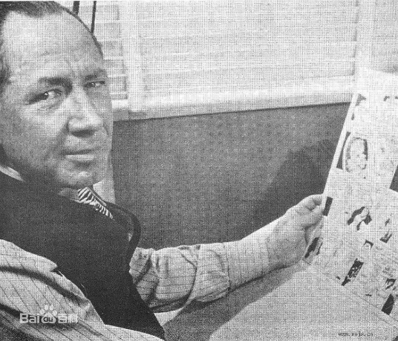
Principle of Testing
Axiom 2 (cont’d) Software testing is a risk-based exercise What about Murphy’s Law?
"If there's more than one possible outcome of a job or task, and one of those outcomes will result in disaster or an undesirable consequence, then somebody will do it that way.”
The law's name stems from an attempt to use new measurement devices developed by one Edward Murphy.
The phrase was coined in reaction to something Murphy said when his devices failed to perform and was eventually cast into its present form prior to a press conference months later.

Slide 28

Principle of Testing
Axiom 3 Testing cannot show the absence of bugs
“Program testing can be used to show the presence of bugs, but never to show their absence!” - Edsger Wybe Dijkstra
Dijkstra received the 1972 ACM Turing Award for fundamental contributions in the area of programming languages

Slide 29

Principle of Testing
Axiom 4 The more bugs you find, the more bugs there are
Bugs appear in groups, where you see one you will likely find more … Why?
Programmers can have bad days
Programmers tend to make the same mistakes
Some bugs are just the tip of the iceberg.
Boris Beizer coined the term pesticide paradox to describe the phenomenon that the more you test software the more immune it becomes to your test cases.
Remedy: continually write new and different tests to exercise different parts of the software.

Slide 30
Principle of Testing
Axiom 5 Not all bugs found will be fixed
Why wouldn’t you fix a bug you knew about?
There’s not enough time
Some deadlines cannot be extended (e.g., Y2K)
It’s not really a bug
Specifications can be wrong
It’s too risky to fix
“I’m not touching Murphy’s code!”
It’s just not worth it
Bugs in fringe features may have to wait
Why not charge the customer for bug fixes in the next release (sound familiar?) :-)

Slide 31
Principle of Testing
Axiom 6 It is difficult to say when a bug is indeed a bug
If there is a problem in the software but no one ever discovers it … is it a bug?
Parody of “if a tree falls in the forest … does it really make a noise?”
What is your opinion? Does a bug have to be observable in order for it to be a bug?
Bugs that are undiscovered are called latent bugs.

Slide 32
Principle of Testing
Axiom 7 Specifications are never final
Building a product based on a “moving target” specification is fairly unique to software development.
Competition is fierce
Very rapid release cycles
Software is “easy” to change
Not true in other engineering domains
E.g., the Brooklyn Bridge could not be adjusted to allow train traffic to cross it once its construction started.

Slide 33
Principle of Testing
Axiom 8 Software testers are not the most popular members of a project
Goal of a software tester:
Find bugs
Find bugs early
Make sure bugs get fixed
Tips to avoid becoming unpopular:
Find bugs early
Temper your enthusiasm … act in a professional manner
Don’t report just the bad news

Slide 34
Principle of Testing
Axiom 9 Software testing is a disciplined and technical profession
When software was simpler and more manageable software testers were often untrained and testing was not done methodically.
Contrary to the urban legend, if you hire a million moneys and have them test for a million years … you will not find all of the bugs in your software.
It is now too costly to build buggy software.
As a result testing has matured as a discipline.
Sophisticated techniques
Tool support
Rewarding careers

Slide 35
Principle of Testing
Some Terminology
Verification
“Are we building the product right?”
Does the software meet the specification?
Validation
“Are we building the right product?”
Does the software meet the user requirements?
Software Quality Assurance
Not the same as software testing …
Create and enforce standards and methods to improve the development process and to prevent bugs from occurring.

Slide 36
Principle of Testing
You now know …
… the 9 axioms of software testing
… what is software verification
… what is software validation
… the relationship between software quality and reliability
… the relationship between testing and quality assurance

Slide 37
Specification and Test Cases
Testing the specification
You do not need to have code to start testing.
Testing the specification can save on time and cost later on.
Also, mistakes in specifications account for about 55% of all bugs.
The specification is typically a written document using prose and pictures to describe the functional and non-functional aspects of the software.

Slide 38
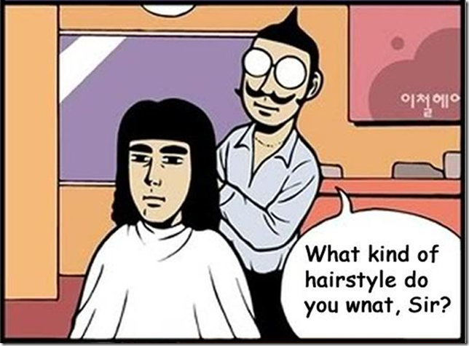
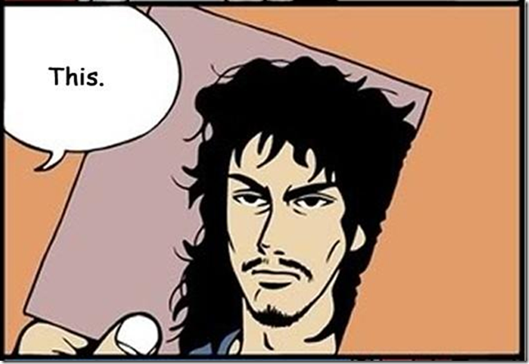
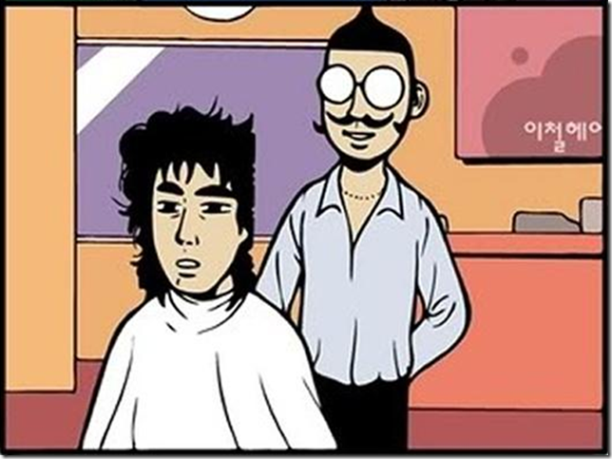
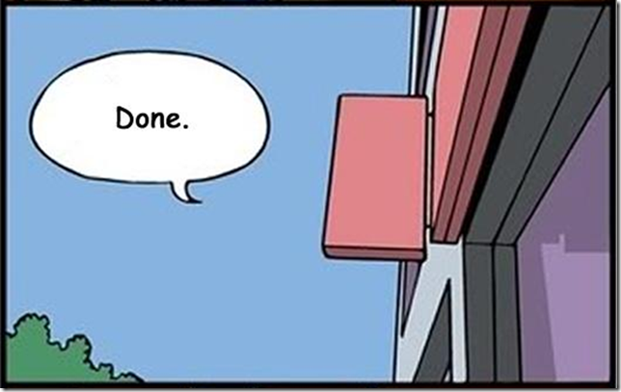
Specification and Test Cases

Slide 39
Specification and Test Cases
Requirements Specification: An Overview
Basic goal: To understand the problem as perceived by the user.
Activities of specification are problem oriented.
Focus on what, not how (this is design)
Don’t cloud the specification with unnecessary detail.
Don’t pre-constrain design in the specification.
After specification is done, do software design:
solution oriented
how to implement the what

Slide 40
Specification and Test Cases
Requirements Specification: An Overview
Key to specification is good communication between customer and developers.
Work from specification document as guide.
Basically, it’s the process of determining and establishing the precise expectations of the customer about the proposed software system.

Slide 41
Specification and Test Cases
The purpose of specification
Raw user requirements are often:
vague
contradictory
impractical or impossible to implement
overly concrete
just plain wrong
The purpose of specification is to get a usable set of requirements from which the system may be designed and implemented, with minimal “surprises”.

Slide 42
Specification and Test Cases
Requirements
Analysis
Specification process
leads to
Requirements
Definition
produces
System
Models
Requirements
Specification
Software
Specification
Requirements
Definition
included in
Requirements
Specification
Software
Specification
Requirements
Document

Slide 43
Specification and Test Cases
The Specification document
The official statement of what is required of the system developers.
Includes system models, requirements definition, and requirements specification.
Not a design document.
States functional and non-functional requirements.
Serves as a reference document for maintenance.

Slide 44
Specification and Test Cases
Two kinds of requirements
Functional: The precise tasks or functions the system is to perform.
e.g., details of a flight reservation system
Non-functional: Usually, a constraint of some kind on the system or its construction
e.g., expected performance and memory requirements, process model used, implementation language and platform, compatibility with other tools, deadlines, ...

Slide 45
Specification and Test Cases
Specification document “requirements”
Should be easy to change as requirements evolve.
Must be kept up-to-date as system changes.
Foreseen problems:
“won’t support Win-3.x apps”
Expected evolution:
“will port to MacOS in next version”
Response to unexpected events/usage:
“if input data in old format, will auto-convert”

Slide 46
Specification and Test Cases
Specification structure
Introduction (describe need for system)
Functional Requirements
Non-Functional Requirements
System Evolution (describe anticipated changes)
Glossary (technical and/or new jargon)
Appendices
Index

Slide 47
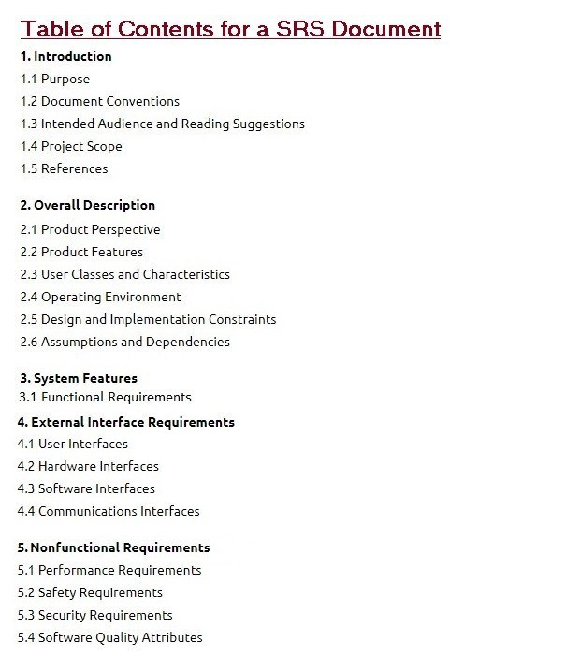
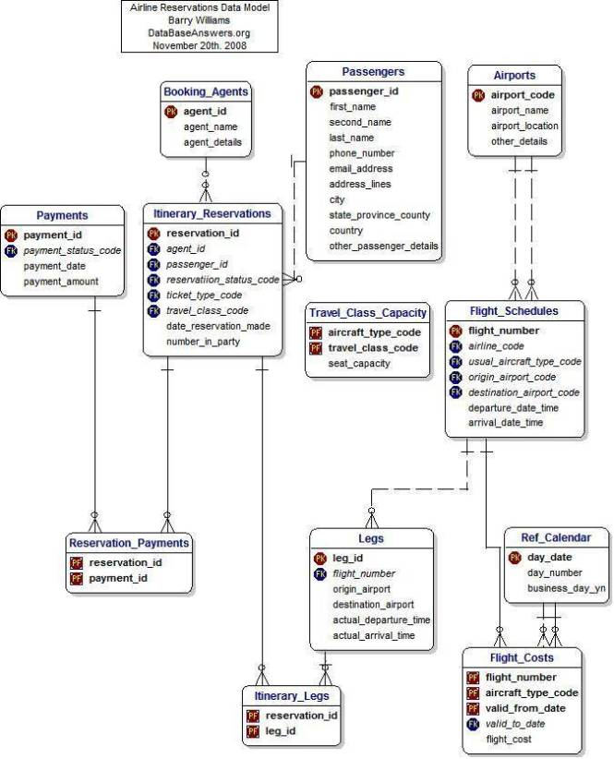
Specification and Test Cases
Specification structure

Slide 48
Specification and Test Cases
To summarize …
Specification focuses on determining what the customer wants, and not how it will be implemented.
Specification is hard to get correct; it requires good communication skills.
Requirements may change over time.
Requirements specification requires iteration.
The customer often doesn’t have good grasp of what he wants.
Bugs created in the requirements stage are very expensive to fix later.

Slide 49
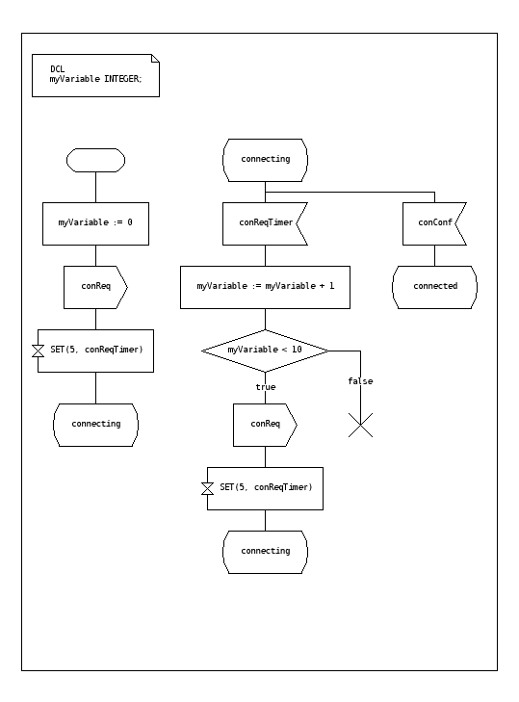
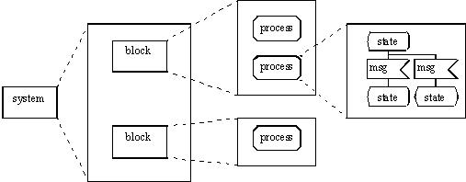
Specification and Test Cases
Specification Languages and Tools
SDL (Specification and Description Language)
SDL is a specification language targeted at the unambiguous specification and description of the behaviour of reactive and distributed systems.

Slide 50
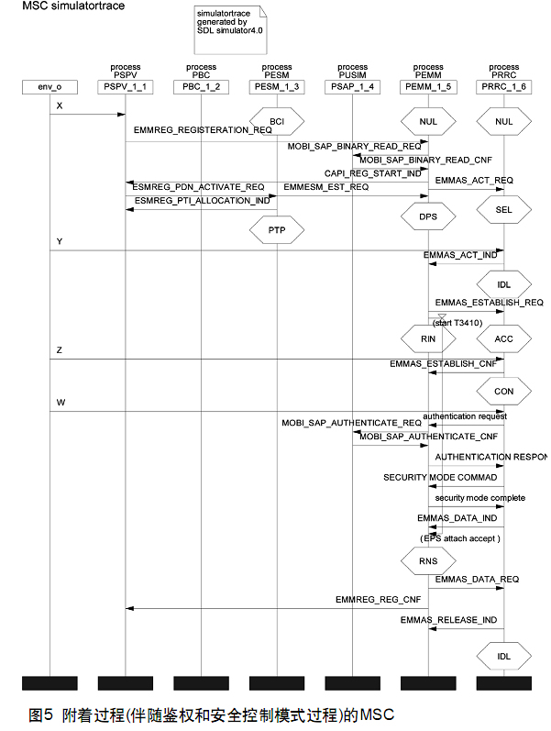
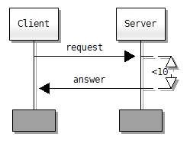
Specification and Test Cases
Specification Languages and Tools
MSC (Message Sequence Chart)
MSC is an interaction diagram from the SDL family standardized by the International Telecommunication Union.

Slide 51
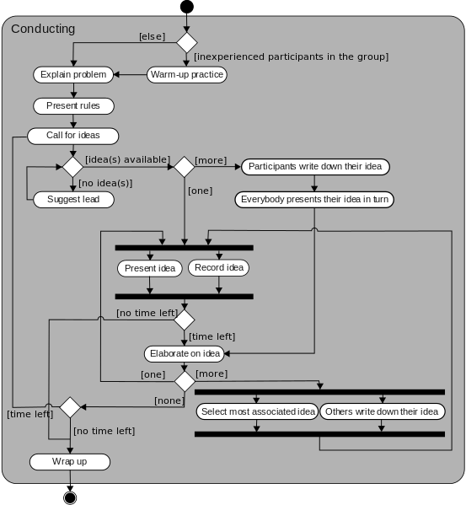
Specification and Test Cases
Specification Languages and Tools
UML (Unified Modeling Language)
UML is a general-purpose, developmental, modeling language in the field of software engineering, that is intended to provide a standard way to visualize the design of a system.

Slide 52
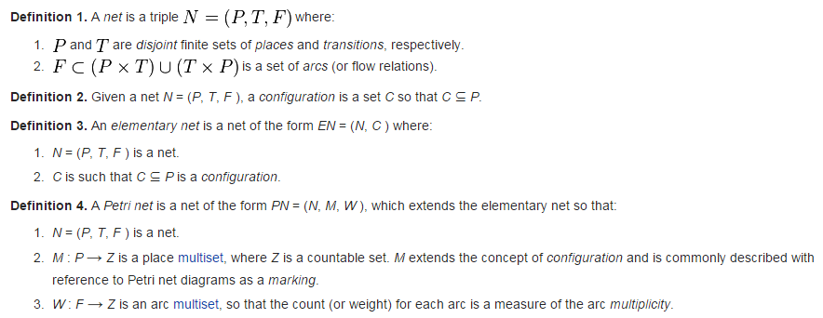
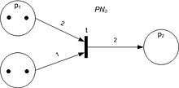
Specification and Test Cases
Specification Languages and Tools
Petri Net
Petri Net is one of several mathematical modeling languages for the description of distributed systems.

Slide 53
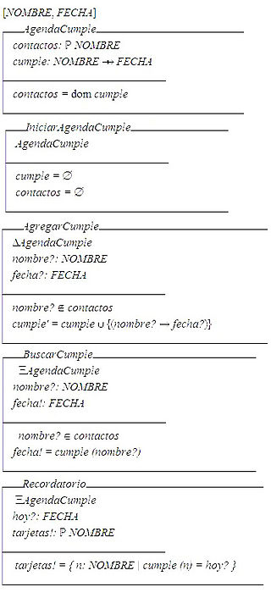
Specification and Test Cases
Specification Languages and Tools
Z notation
Z notation is a formal specification language used for describing and modelling computing systems. It is targeted at the clear specification of computer programs and computer-based systems in general.

Slide 54
Specification and Test Cases
Specification reviews
Involve people examining the specification with the aim of discovering anomalies and defects.
Reviewers reuse domain knowledge so they are likely to have seen the types of error that commonly arise.
Does not require the execution of a system so may be used before implementation.
Effective technique for discovering errors.

Slide 55
Specification and Test Cases
Reviews and testing
Reviews and testing are complementary and not opposing verification techniques.
Both should be used during the V & V process.
Reviews can check conformance with a specification but not conformance with the customer’s real requirements.
Reviews cannot check non-functional characteristics such as performance, usability, etc.

Slide 56
Specification and Test Cases
Review pre-conditions
A precise specification must be available.
Team members must be familiar with the organization standards.
Management must accept that reviews will increase costs early in the software process.
Management must not use reviews for staff appraisal.

Slide 57
Specification and Test Cases
What is a specification review?
A process of identifying faults in the specification of a software system.
Review should uncover both errors made in producing specification documents, and errors made earlier in the requirements engineering process.

Slide 58
Specification and Test Cases
Limitations of conventional review approaches
Too much information to go through, and not enough time to do it thoroughly.
Unfamiliarity of individual reviewers with the overall goals of the design.
No single part of the specification gets a thorough and complete evaluation.
Burden is on reviewer to initiate action.
One-on-one interaction between individual reviewers and specification team is limited.

Slide 59
Specification and Test Cases
Better method: Active specification review process
Change from “general” review to a set of more focused reviews.
Use questionnaires to engage the reviewer in using the specification.
More opportunities for one-on-one discussion between reviewer and specification team.

Slide 60
Specification and Test Cases
An example
We have been asked to review the specification for a hospital’s order processing system.
The order processing system allows users to order items for patients, such as tests or medications.

Slide 61
Specification and Test Cases
Active specification review process Step 1: Prepare the specification for review
Think about what criteria reviewers will use:
Well-structured
Simple
Adequate
Flexible
Practical
Easy to implement
Standardized

Slide 62
Specification and Test Cases
Active specification review process Step 2: Prepare the documentation for review
Make assumptions explicit
System can record the order pertaining to a patient.
It is possible to obtain all the orders for a patient.
System can determine and change the status of an order.
The order always contains at least one item.
The status of an order is always in one of the two states i.e active or cancelled.
Incorrect Usage Assumptions
Cannot add or remove items once the order is placed.
Once an order is cancelled, the status cannot be set to active again.
An item is always added with respect to an order.

Slide 63
Specification and Test Cases
Active specification review process Step 3: Identify the specialized reviews
Focus the reviewer’s attention on specific properties of the specification (e.g., data access).
Data access sufficiency.
E.g., provides all data required by the other features of the system.
Assumption Sufficiency.
E.g., contains all of the assumptions needed to access the feature’s data.

Slide 64
Specification and Test Cases
Active specification review process Step 4: Identify the reviewers needed
People with different perspectives and expertise are needed as reviewers
Programmers and analysts who worked on the other features of the order processing system.
Programmers and analysts familiar with hospital information systems in general.

Slide 65
Specification and Test Cases
Active specification review process Step 5: Design the questionnaires
Make reviewers take an active role
Make reviewers use the documentation
Phrase questions in an active way
E.g., “Write down the exceptions that can occur” rather than “Are exceptions defined for every program?”

Slide 66
Specification and Test Cases
Active Specification Review Process Step 6: Conduct the review
Present an overview of the specification.
Assign reviews to the reviewers.
Reviewers complete their reviews, meeting with the specification authors as needed.
Specification authors review completed questionnaires, and meet with reviewers to resolve questions.
Specification authors produce new version of the specification.

Slide 67
Specification and Test Cases
Specification attribute checklist
Completeness
Accuracy
Precision
Consistency
Relevance
Feasibility
Code/Design-free
Testability

Slide 68
Specification and Test Cases
Specification terminology checklist
Always, every, all, none, never, … (absolutely sure?)
Certainly, therefore, clearly, obviously, customarily, most, … (persuasion lingo)
Some, sometimes, often, usually, ordinarily, customarily, most, … (vague)
Etc., and so forth, and so on, such as, … (not testable)
Good, fast, cheap, efficient, small, stable, … (unquantifiable)
Handled, processed, rejected, skipped, eliminated, …
If … then … (missing else)

Slide 69
Specification and Test Cases
Conclusions
Reviewers focus on those areas they are best suited to evaluate
Time is used more wisely for all participants
More errors are likely to be found
One-on-one communication with specification authors makes it easier for people to speak up.
Few errors found does not necessarily indicate that the specification is good.
E.g., Perhaps the review process was not effective.

Slide 70
Specification and Test Cases
You now know …
… what a specification is
… how to review (test) a specification
… the benefits of an “active” specification review process

Slide 71
To be continued… See you next week

